Slide 1
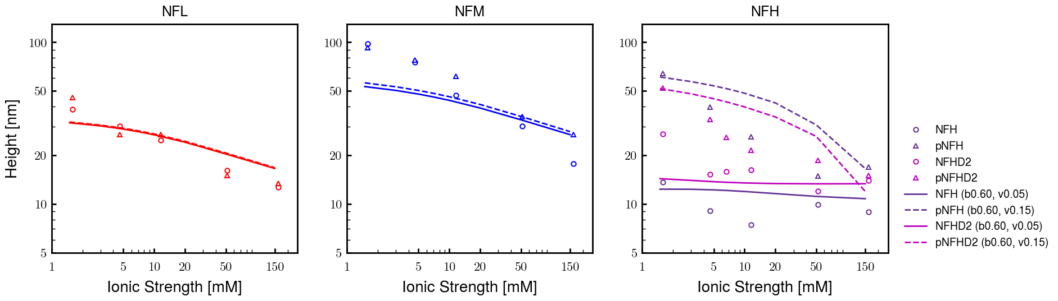
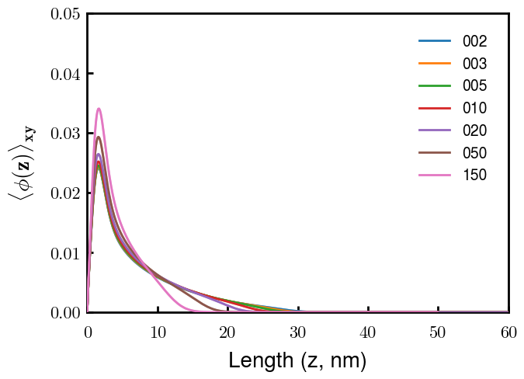
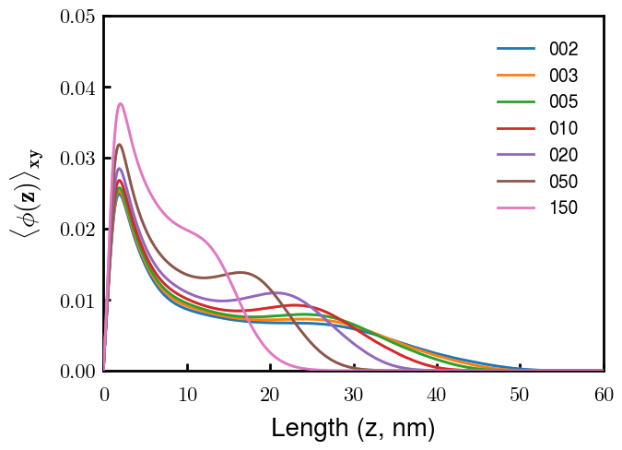
NFL
NFM
Next slide
Notes
pNFM running now; NFHb60v05c150 (cm225) running now
All non-phos same b,v
Phos L, M same as non-phos (few KsP)
Phos H 0.05 → 0.15 nm3
Potential improvements
Recheck pNFH(D2); no better option?
Recheck NFM; no better reasoning than b(s)?

Slide 2
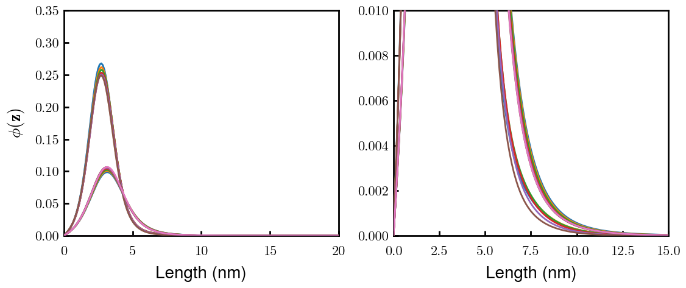
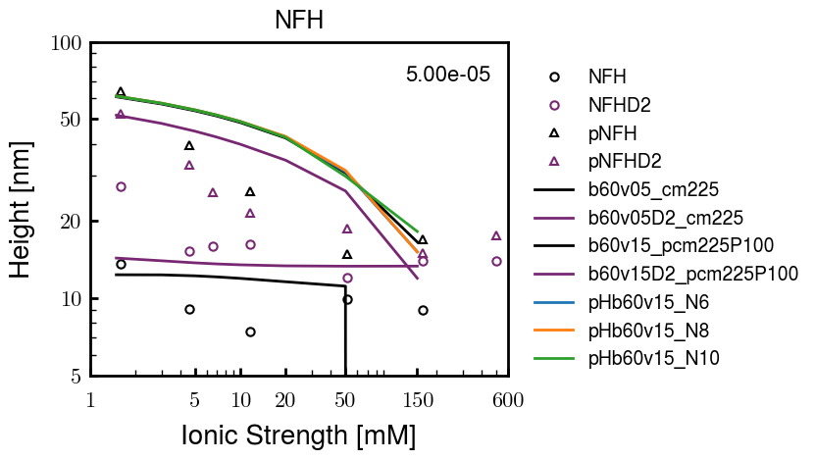
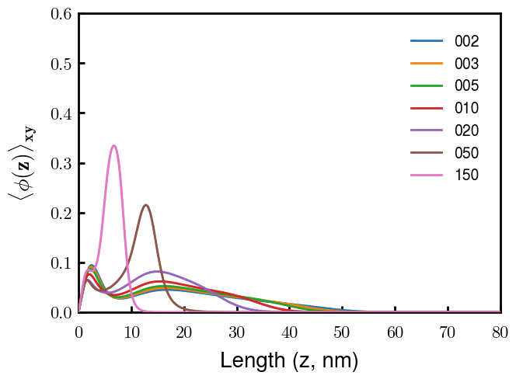
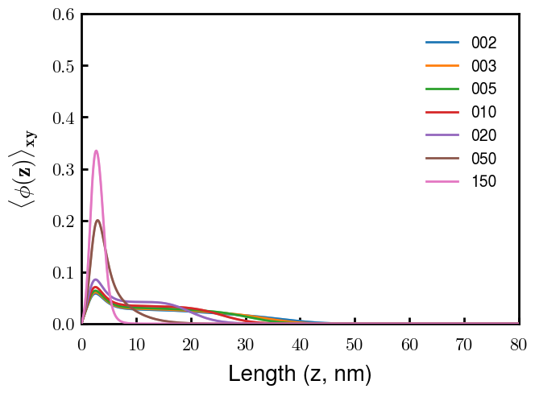
(p)NFH(D2)
NFH
NFHD2
pNFH
pNFHD2
(v = -1)
Points
v05 → v15 after phosphorylation
No condensed multilayer but worse fit

Slide 3
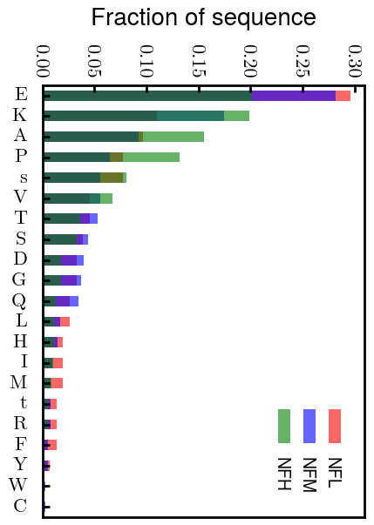
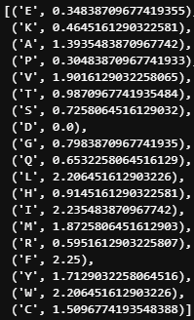
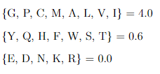
Chi (scaled)
Chi (BM 2023)
D: 3.65 (-1.00e);
E: 4.25 (-1.00e);
K: 10.53 (1.00e);
R: 12.48 (1.00e);
H: 6.00 (0.035e)
Note: N should be in bin 2 (not in NFH anyways)
Biggest discrepancies between scaled and Zhulina: P (0.30 → 4.00), K (0.46 → 0.00), R (0.60 → 0.00)
(PKR has effect on pNFH; isolate P—currently seems too hydrophobic)

Slide 4
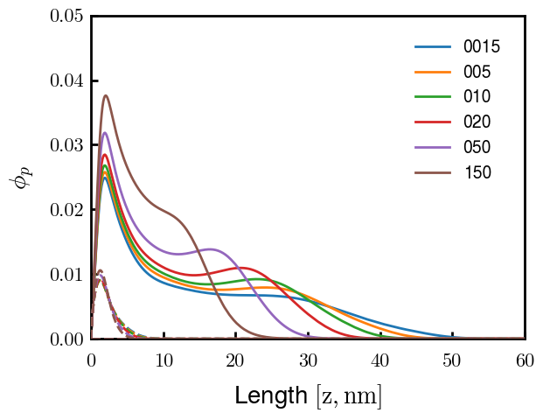
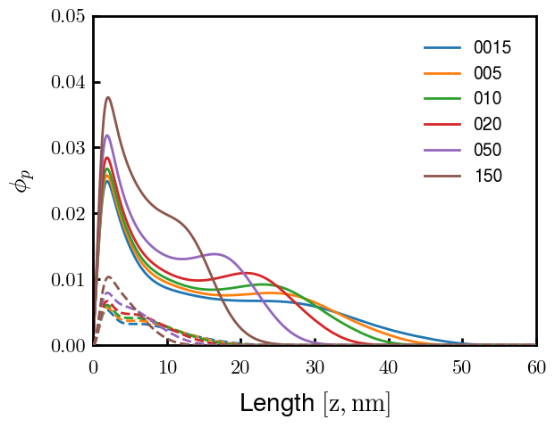
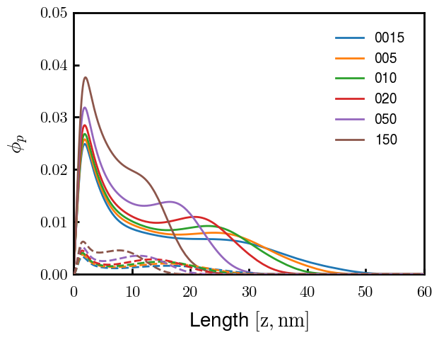
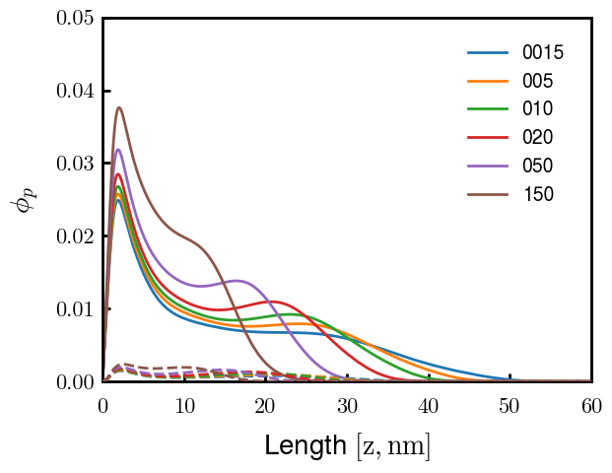
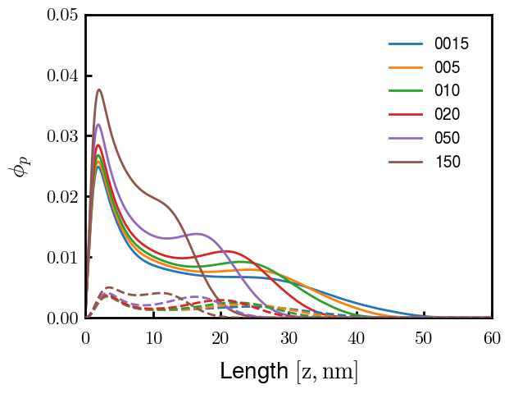

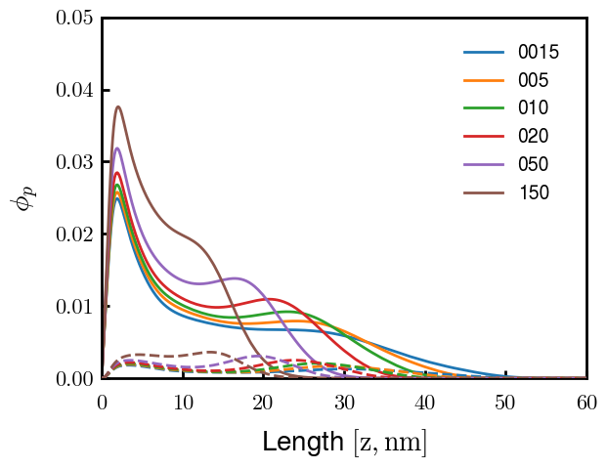
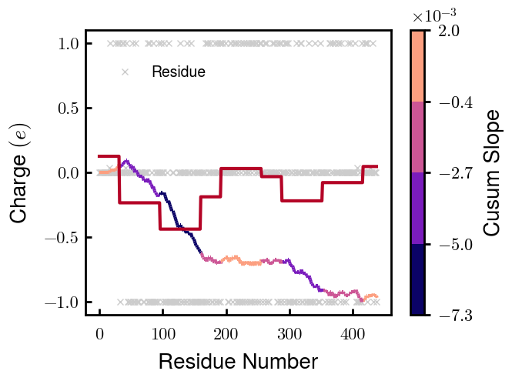

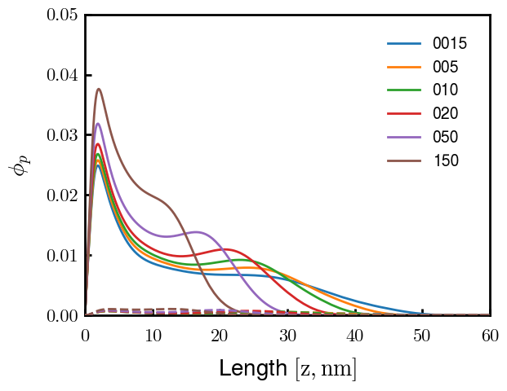
3
4
1
2
6
7
5
8
9

Slide 5
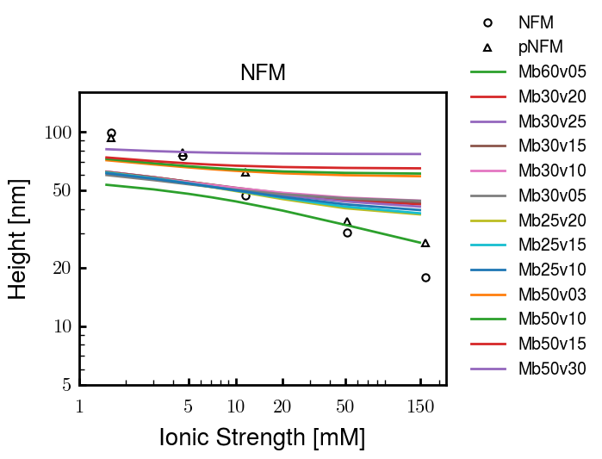
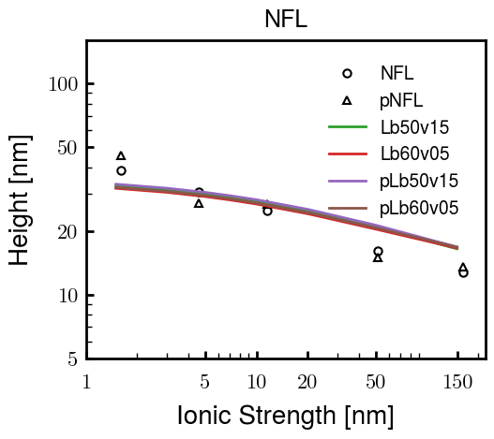
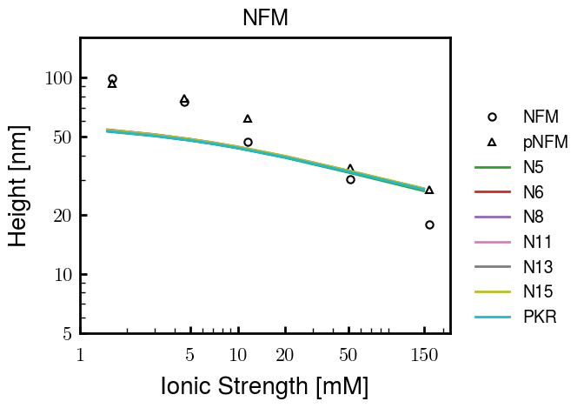
Other fits
pNFH P study next slide

Slide 6
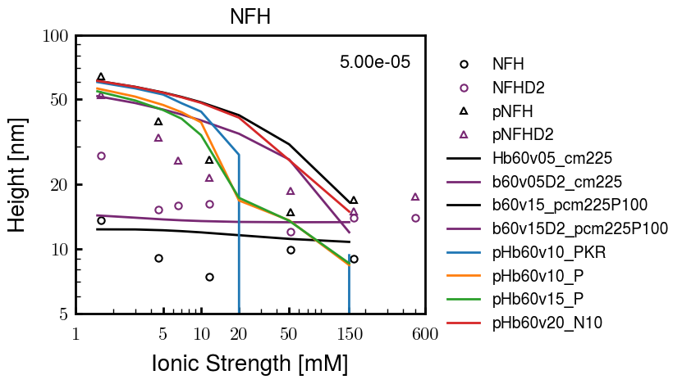
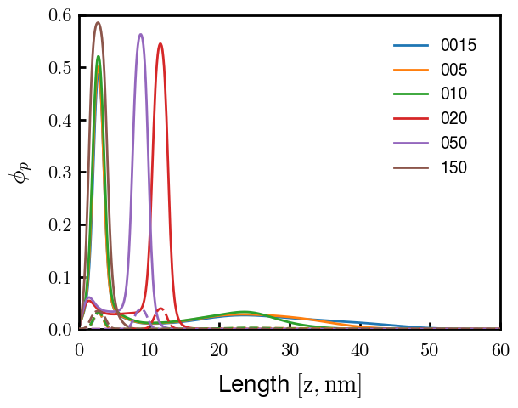
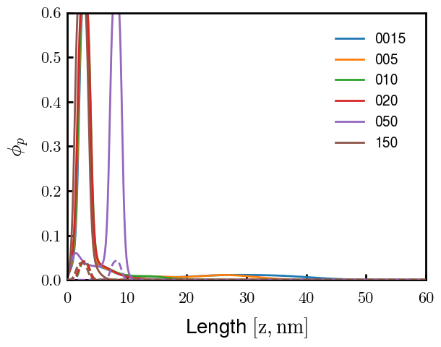
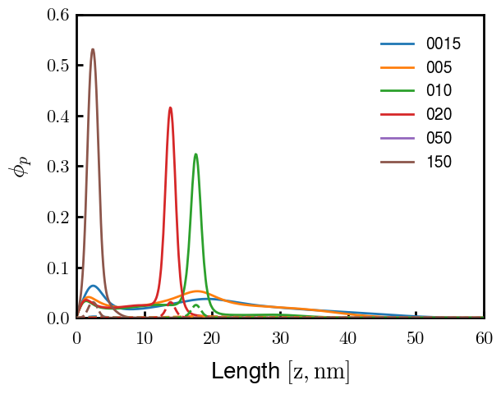
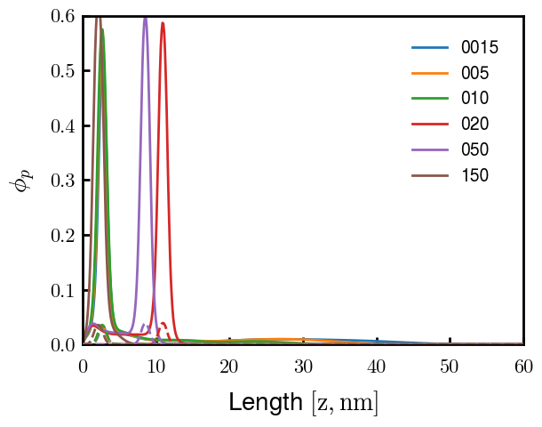
pHb60v15_PKR
pHb60v15_P
pHb60v10_PKR
pHb60v10_P
PKR identified as amino acids with high discrepancies between expt and Zhulina bins
P isolated and good trend (change P to max, 2.25)
Even though better H, some conformational changes. Try to avoid by decreasing (in prog).
Single outer peak may not be bad— “flower” conf?
At the very least, increase high cs height and check NFHD2 (and eventually NFL, NFM)
Ensure effect does not ruin NFH(D2) (after screening)

Slide 7





Slide 8
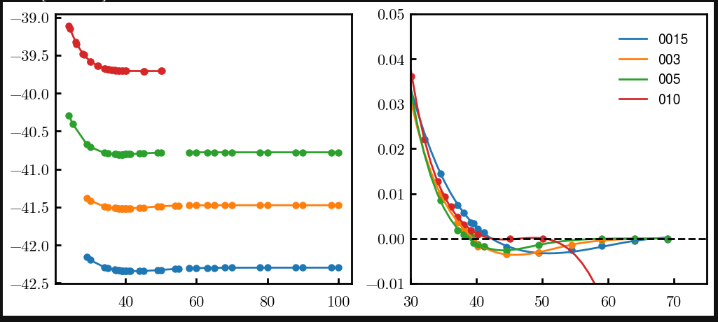
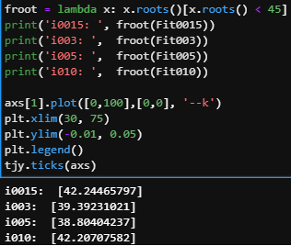
Try approaching surface

Slide 9




NFH (original); 31, 4
NFHD2; 40, 4
D2: delete 36-72
Rerun alg on D2
NFH (phos); 36, 4
NFHD2 (phos); 33, 4
Note: not currently doing this

Slide 10
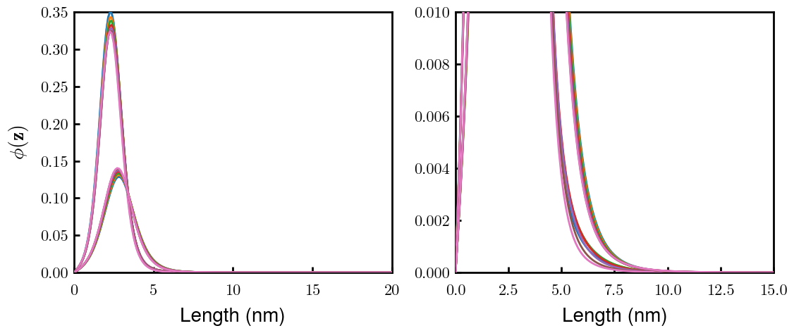
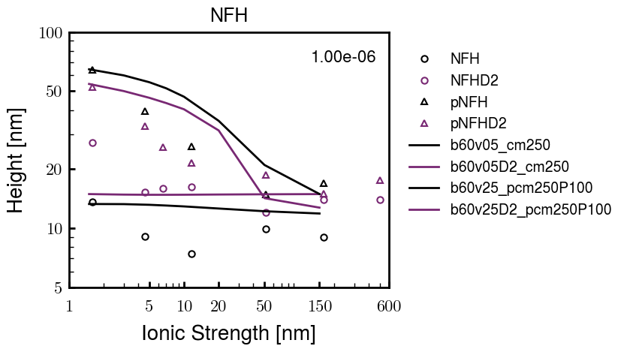
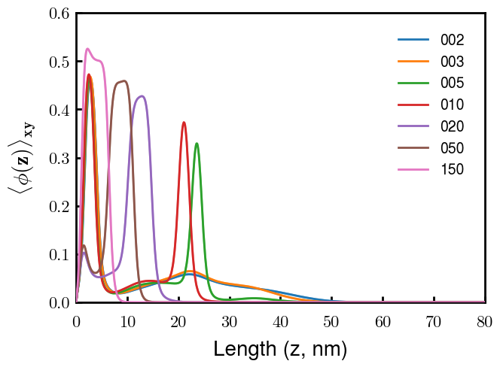
Best fit w/ consistent chi_max
NFH
NFHD2
pNFH
(v = -1)
Points
v05 → v25 after phosphorylation
Bilayer (trilayer for 5?) pNFH morphology

Slide 11
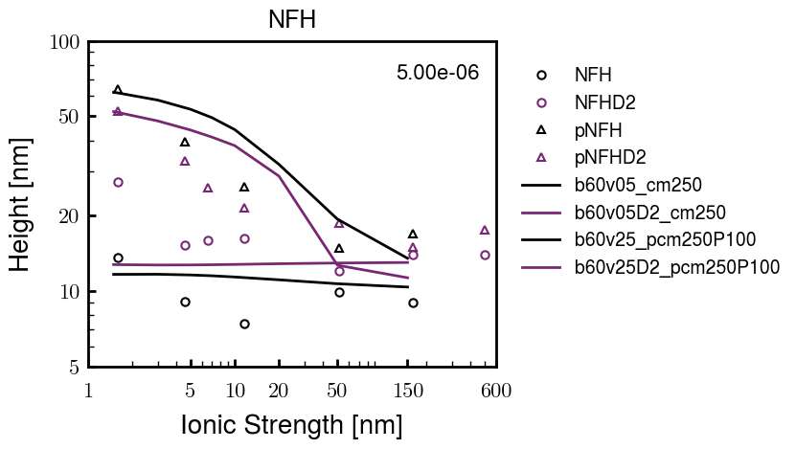
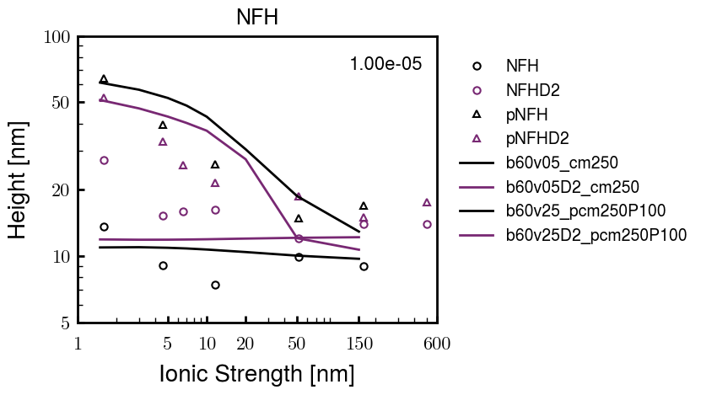
Same params as prev. w/ diff thresh

Slide 12
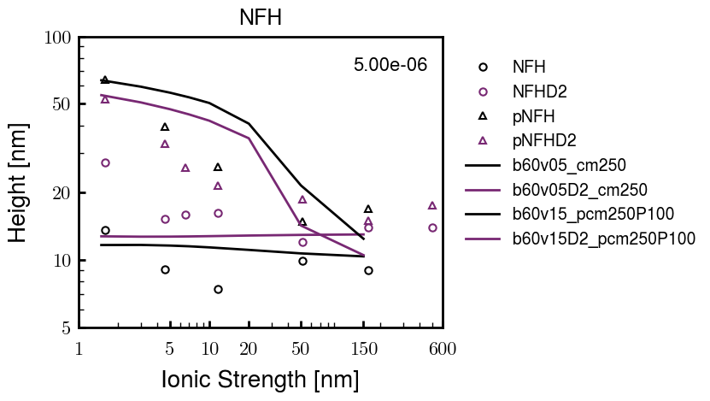
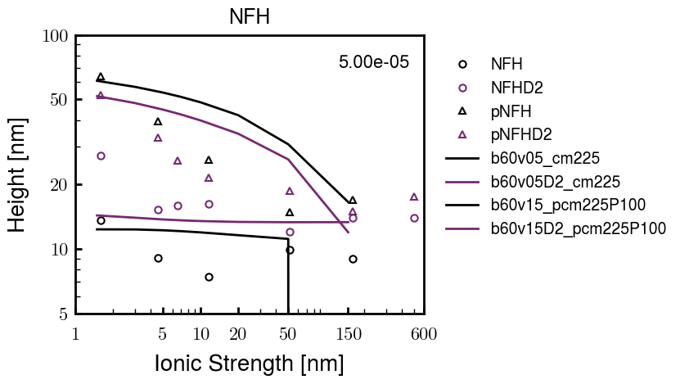
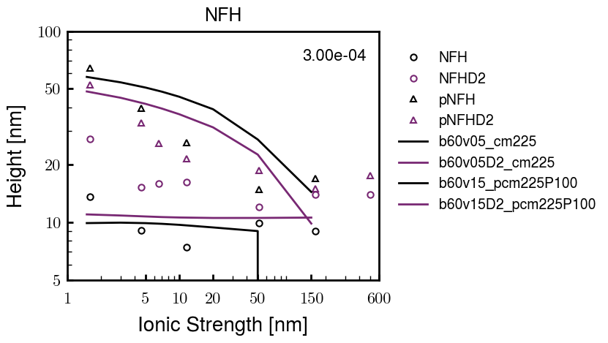
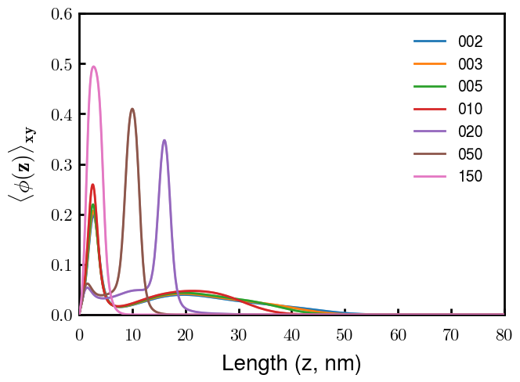
Find best without multilayer
pNFH
pNFH
(v = -1)
(v = -1)
Multilayer at 20

Slide 13
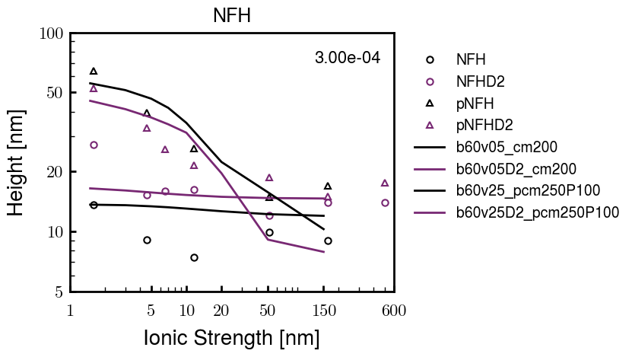
Best pNFH scaling fit (no regard to realistic)
pNFH
(v = -1)
Points
v05 → v25 after phosphorylation
cm200 → cm250 after phospho
Multilayer
Phospho < native

Slide 14






Native NFH

Slide 15







NFHD2

Slide 16




pNFH(D2)
4e-03

Slide 17





1e-06
4e-03
norm
4e-03
Try to bring pNFH down → {cmXX + PXX} only choice
norm
4e-03

Slide 18

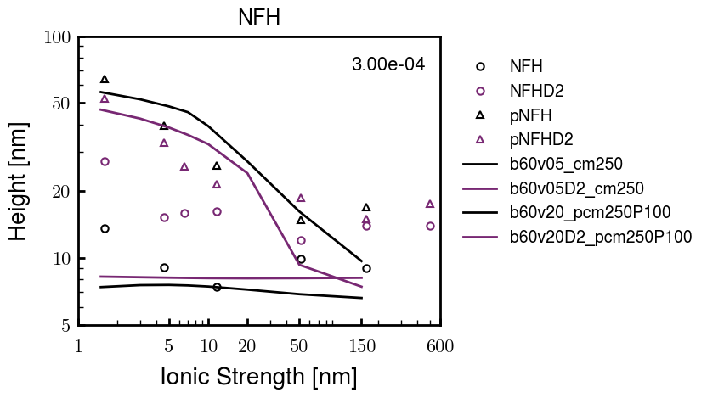


3e-04
3e-04
3e-04

Slide 19





Heights.params : b60v05 cm200
norm
1e-06
1e-05
1e-04
4e-03

Slide 20






Heights.params : b60v05 cm250
norm
ylog
norm
ylin
1e-06
1e-05
1e-04
5e-03

Slide 21




Heights.params: b60v10 cm{200, 225}
norm
1e-06
1e-05
1e-04
5e-03

Slide 22



Slide 23

 | Slope Bins 4 | Smear Count 25
Block number | Alpha w/ Henderson Hasselbalch | Chi Chi_max = 2.2
[0 50] | 0.040012 | 1.160000
[50 75] | -0.278451 | 0.720000
[75 125] | -0.519707 | 0.608000
[125 156] | -0.154453 | 0.529032

Slide 24

 | Slope Bins 4 | Smear Count 31
Block number | Alpha w/ Henderson Hasselbalch | Chi Chi_max = 2.2
[0 31] | 0.001103 | 0.922581
[31 62] | -0.386873 | 0.703226
[62 93] | -0.290146 | 0.967742
[93 496] | 0.037164 | 1.098759
[496 527] | -0.064533 | 0.819355
[527 620] | 0.010682 | 0.756989
[620 647] | -0.103326 | 0.696296

Slide 25






Previous
New

Slide 26





Slide 27


Response to stimuli given composition
Same data
Effect of composition given environment

Slide 28


NFL, pH 7.44, phos 1.5e (locs from LCMS)
Non-phos NFL
Block number | Alpha w/ Henderson Hasselbalch | Chi Chi_max = 3.2
[0 50] | 0.040012 | 1.540000
[50 75] | -0.278451 | 0.960000
[75 125] | -0.519707 | 0.868000
[125 156] | -0.154453 | 0.690323
 | Slope Bins 4 | Smear Count 25
Block number | Alpha w/ Henderson Hasselbalch | Chi Chi_max = 3.2
[0 50] | -0.019988 | 1.540000
[50 75] | -0.278451 | 0.960000
[75 125] | -0.519707 | 0.868000
[125 156] | -0.154453 | 0.690323

Slide 29

NFM, pH 7.44, phos 1.5e (locs from LCMS)
 | Slope Bins 4 | Smear Count 32
Block number | Alpha w/ Henderson Hasselbalch | Chi Chi_max = 3.0
[0 32] | 0.079143 | 1.275000
[32 64] | -0.186340 | 1.125000
[64 96] | -0.327964 | 1.181250
[96 160] | -0.460694 | 0.787500
[160 224] | -0.124999 | 1.115625
[224 288] | -0.023510 | 0.956250
[288 352] | -0.242085 | 1.003125
[352 384] | -0.031302 | 1.125000
[384 416] | -0.123860 | 1.050000
[416 438] | 0.046945 | 1.281818

Slide 30





Bin 3 NFM, pH 7.44, phos 1.5e (locs from LCMS)

Slide 31




Bin 5 NFM, pH 7.44, phos 1.5e (locs from LCMS)

Slide 32



Phos 2 NFM, pH 7.44, phos 2.0e (locs from LCMS)

Slide 33



Chi 2.5 NFM, pH 7.44, phos 2.0e (locs from LCMS)

Slide 34



NFM, pH 7.44, non-phos

Slide 35


NFH, pH 7.44, phos 1.5e (locs from LCMS)
 | Slope Bins 4 | Smear Count 36
Block number | Alpha w/ Henderson Hasselbalch | Chi Chi_max = 3.2 | Chi Chi_max = 3.0
[0 36] | 0.000945 | 1.266667 | 1.20000
[36 72] | -0.527455 | 0.900000 | 0.85000
[72 324] | -0.208376 | 1.729365 | 1.628571
[324 396] | -0.111195 | 1.416667 | 1.333333
[396 432] | -0.152824 | 1.344444 | 1.266667
[432 647] | -0.033955 | 1.077209 | 1.015814

Slide 36




Phos block dashed
Phos block dashed

Slide 37



Best are b3.0 v2.0 and b3.0 v3.0, but max H not high enough
Possible solutions:
Lower chi_max
Change aa_disc to have more charge
Force spectra?
Better for low salt, but high salt will melt brushes together

Slide 38



M1
pMx5

Slide 39



b3.00; v1, 2
b4.00; v2, 2.5, 3, 5, 10
b5.00; v3, 10, 15, 40
53 Nk
39 Nk
32 Nk

Slide 40
Binary results

Slide 41



Matrix Approach
Updated 04/04/2023

Slide 42














H Vol decrease (by v)
H Vol decrease (by b)
Desired “linearity” by tuning /thresh/ based on polymer density of expelled NFL
L Vol decrease (by b)
Comes at severe cost of overall height. Have to minimize outer concentration to approach pure thresh of 1e-06

Slide 43














H Vol decrease (by v)
H Vol decrease (by b)
Chimax 3.5
Desired “linearity” by tuning /thresh/ based on polymer density of expelled NFL
L Vol decrease (by b)
Comes at severe cost of overall height. Have to minimize outer concentration to approach pure thresh of 1e-06

Slide 44








F (3.5)
Chimax 3.5
Chimax 3.0
Scaled by 1.5
Scaled by 1.6
Scaled by 1.6
Scaled by 1.5
Scaled by 1.5
Scaled by 1.5
Scaled by 1.8
Scaled by 1.8

Slide 45
















Last test: same stiffness factor (b^3/v0) but with varying total volume

Slide 46












H Vol decrease (by v)
H Vol decrease (by b)
a2C_30
a2D_30
a2E_30
Rerun for Cs
b1C_30
b1D_30
b1E_30
L Vol decrease (by b)
a1C_30
a1D_30
a1E_30
g1C_30
g1D_30
g1E_30
Rerun for Cs

Slide 47












H Vol decrease (by v)
H Vol decrease (by b)
a2C
a2D
a2E
b1C
b1D
b1E
Block 4 (NFL end)
L Vol decrease (by b)
a1C
a1D
a1E
g1C
g1D
g1E

Slide 48









H Vol decrease (by v)
Chimax 3.5
H Vol decrease (by b)
a2C_30
a2D_30
a2E_30
b1C_30
b1D_30
b1E_30
L Vol decrease (by b)
a1C_30
a1D_30
a1E_30
g1C_30
g1D_30
g1E_30

Slide 49







For i as L and H:
Pure height profiles
Mixed height profiles
Current L library
Current H library
Skip; marginal increase in vol prob not enough
Move onto chi3.0; larger NFL vol library

Slide 50





NFL
All plotting wrong L pure; look only at purp
NFH
H volume too low to neutralize L (v = 31 nm3/c)

Slide 51







H volume v = 60 nm3/c

Slide 52







H volume too low to neutralize L

Slide 53










NFH, V = 70
L30

Slide 54





NFH & NFL v = 0.15
a2D
b1D
g1D

Slide 55





Based on NFH b5v15c3, apply VL = VH
NFL and NFH are from same amino acids but diff chain lengths. Should VL = VH?
L30 / H70
L80 / H20
L30 / H70
L80 / H20

Slide 56






L30 / H70
L80 / H20
L30 / H70
L80 / H20

Slide 57
L Fitting

Slide 58


VL = VH

Slide 59







Try b change, v same as H (0.15)
Phi unrealistic (?)
Phi unrealistic
Phi very unrealistic
Phi very unrealistic

Slide 60






Try similar params to H
5.6
11.2
16.8
28
56
7.5
11.25
18.75

Slide 61







Try similar params to H, b0.36
7.8
15.6
23.4
31.2
Unrealistic vol
Not very sensitive to v; not high enough to intersect neighboring chains (function of b and sigma)

Slide 62


Continuation from prev params

Slide 63







v2.7 and some fine
b1.50 v2.7 c3.2
b1.75 v2.7 c3.2
b1.75 v2.5 c3.2
b1.75 v2.5 c3.0
b2.0 v2.7 c3.2
b2.25 v2.7 c3.2
b2.50 v2.7 c3.2
Phi too small to decrease v0

Slide 64










b2.0 v10.0 c3.0
b2.0 v8.0 c3.0
b2.0 v6.0 c3.0
b2.0 v4.0 c3.0
b2.0 v2.0 c3.0
Phi limit
b1.8 v10.0 c3.0
b1.8 v8.0 c3.0
b1.8 v6.0 c3.0
b1.8 v3.0 c3.0
b1.8 v2.0 c3.0
Phi limit

Slide 65





b1.6 v10.0 c3.0
b1.6 v8.0 c3.0
b1.6 v6.0 c3.0
b1.6 v2.0 c3.0
b1.6 v1.5 c3.0
Phi limit

Slide 66









b2.0 v2.7 c3.2
b3.0 v3.5 c3.5
b3.0 v7.0 c3.5
b3.0 v7.0 c3.0
Phi too small
Phi too small to decrease v0
b4.0 v12.0 c3.0
b5.0 v20.0 c3.0
b5.0 v20.0 c4.0
b5.0 v5.0 c3.0
b5.0 v10.0 c3.0
Phi too small to decrease v0

Slide 67





v20
b5.0 v20.0 c3.0
b4.5 v20.0 c3.0
b4.0 v20.0 c3.0
b3.5 v20.0 c3.0
v10
b5.0 v10.0 c3.0
b4.0 v10.0 c3.0
b3.0 v10.0 c3.0
b2.0 v10.0 c3.0

Slide 68




b2.00 v2.70 c3.20
b2.00 v2.75 c3.20

Slide 69
NFH fitting (from NFL best fit)

Slide 70








b1.00, v0.50, c3.2
b2.00, v4.00, c3.2, th2.5e-02
b1.00, v2.00, c3.2
b1.00, v1.00, c3.2

Slide 71
Mixture

Slide 72



Slide 73


b = 0.75

Slide 74





Slide 75
b = 1.0

Slide 76





Slide 77
b = 1.25

Slide 78




Chi 2.6
Bad vol frac

Slide 79








b25v0
b25v1
b25v2
b25v3

Slide 80




Chi 2.8
Bad vol frac

Slide 81





Slide 82
b = 1.50

Slide 83






Chi 2.8
Bad vol frac

Slide 84





Slide 85

b = 2.00
v4 = 0.25*b^3

Slide 86


Bad vol frac

Slide 87



Slide 88
Fine tune

Slide 89



b1.25, v1.95, c3.0
b1.50, v3.38, c3.0
b2.00, v4.00, c3.0
Norm seems to capture kinked behavior

Slide 90




Slide 91



b1.25, v1.95, c3.2
b1.50, v3.38, c3.2
b2.00, v4.00, c3.2

Slide 92




Slide 93


b1.25
b1.50
b2.00
c2.8
c3.0
c3.2

